Slide 1
All About SQL Injection
Increase Security, Understand Exploits, and Prevent Disaster!
Edward Pollack
Microsoft Data Platform MVP

Slide 2
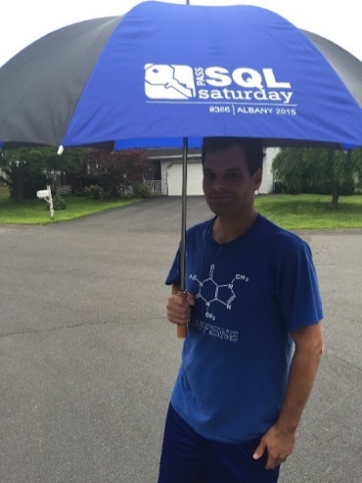





Ed Pollack
Microsoft Data Platform MVP
Published author of:
Dynamic SQL: Applications, Performance, and Security, 2nd Edition
Analytics Optimization with Columnstore Indexes in SQL Server
Published in Expert T-SQL Functions in SQL Server, 3rd Edition
Expert Performance Indexing in SQL Server, 4th Edition
Author on SQLServerCentral, SQLShack, and Simple Talk.
Organizes:
SQL Saturday New York City
Future Data Driven
Capital Area SQL Server User Group
Speaker at many data events
Find me on: LinkedIn

Slide 3
Agenda
Intro to SQL Injection
SQL Demos: SQL Injection
Detection and Prevention
Application Considerations
SQL Demos: SQL Injection Prevention
Questions & Wrap-up

Slide 4
What is SQL Injection?
Injection is manipulating inputs to insert unintended code into an application.
SQL injection does this via SQL code.
Was the #1 security exploit for years (is currently #3)
New #1 is Broken Access Control and #2 is Cryptographic Failures.
Is not less prevalent, though!
SQL injection is successful if a user can access any data or SQL Server components that are not intended for them.

Slide 5
Examples of Exploits
Modify web URL strings.
Insert/modify text of dynamic SQL statements.
Fill out freeform text fields with unintended/unexpected inputs.
% ‘ “ & or keywords
Employee/internal resource abuses their access.
Probe to get non-app-generated error messages.
Social engineer details that can further an attack.
Find/exploit Easter Eggs.
Performance bombs.

Slide 6
Why Does This Matter?
Do You Want a Data Breach?
(sung to the tune of “Do you Want to Build a Snowman?”)

Slide 7
Basic SQL Injection
Demo

Slide 8
Common Causes of SQL Injection
Old, legacy, or lazy code.
Assumptions by any development group that their app is secure.
Past success = future success assumption.
Moving too fast to stop and consider security.
Using unsupported, outdated, or unpatched applications.
Database app, web server, operating system, hardware, network, etc…
Failure to layer security on multiple levels.

Slide 9
There are 2 Kinds of Error Messages…

Slide 10
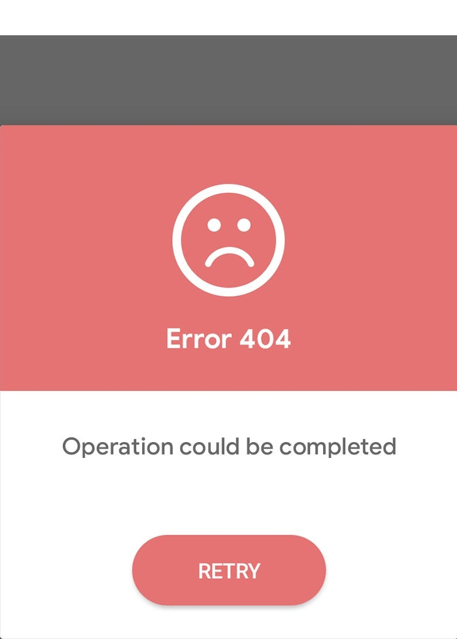
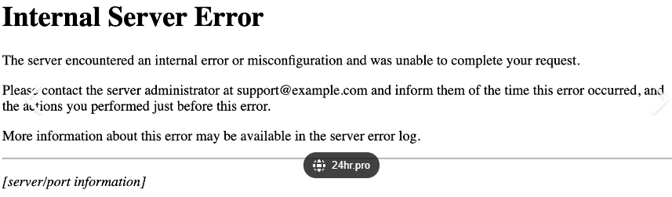
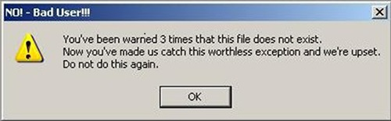
Intentional Error Messages:

Slide 11
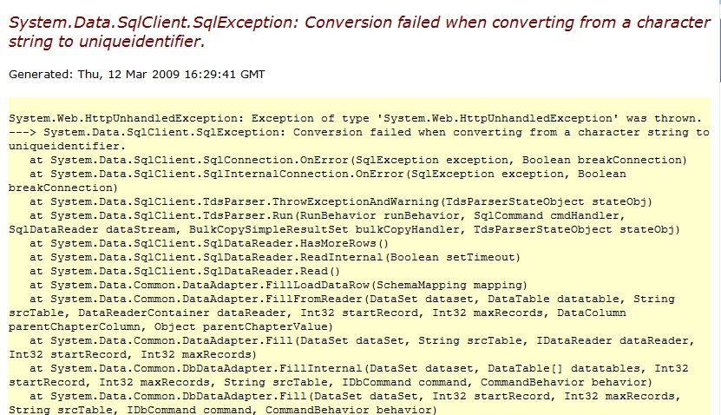
Unintentional Error Messages:

Slide 12
SQL Injection: What Can Access Allow?
Modify existing TSQL to return additional data (including sensitive data)
Adjust TSQL to insert new scripts.
Test existence and nature of database and server objects.
Alter passwords or permissions.
Access components outside of the SQL Server.
Employ a DDOS or other attack as a decoy.
Exploit bugs in application/database code.
Drop, mangle, steal, alter, or ransom data.

Slide 13
Exploiting SQL Injection Input form/login form abuse
Demo

Slide 14
Is the Answer to Write Better Code?
This is one answer, but not the complete answer!!!
We do not have the time/resources to review and rewrite everything.
We cannot control the application code of every employee.
We cannot anticipate all bugs in application, vendor, or platform software.
Applications interact and evolve over time in ways we may not foresee.
We are human.

Slide 15

Onion Security
(Onions have layers)

Slide 16
Defending Against SQL Injection
Sanitize inputs at ALL levels of an application.
Beware empty strings, regex abuse, wildcards, NULL, symbols, etc…
Minimize the direct use of user-generated input to necessary cases.
Consider non-free form text when possible.
Avoid dynamic SQL for user-facing solutions.
If needed, ensure thorough input sanitization!
Ensure apps/tools are updated!
NEVER return system errors to the end-user. Have app-generated errors!
Parameterize stored procedures and queries to improve input control.

Slide 17
Defending Against SQL Injection+
Limit result sets to what is needed (Use TOP!). Prevent performance bombs.
Perform thorough data validation, including variable length/size.
Implement security on application, network, database, and web tiers.
Onions have LAYERS. So should your security!
Don’t forget backups, vendor software, and logging apps
Limit use of xp_cmdshell and extended stored procedures.
Prevent application logins from accessing SQL Server Agent, Powershell, SSIS, SSRS, file shares, external programs, etc…
Have monitoring/tools that check for suspicious activity.
App logs, web requests, API logs, web traffic, etc…

Slide 18
Principle of Least Privilege
Ensure accounts have least privilege to perform their function.
Avoid sysadmin for anyone/anything that isn’t actually a sysadmin.
Avoid db_owner database role for application logins.
Do not use sa. Set an insane password, disable it, and forget it exists.
Separate roles for different applications, users, and system processes.
Windows authentication vs. SQL Server authentication.
Using SQL Auth? Ensure passwords are secure. Really secure.

Slide 19
Preventing SQL Injection
Demo

Slide 20
Tools We Can Use
Web, application, Windows, and event logs.
Penetration/security tests.
Code review! Assume anyone can make mistakes and check for them!
3rd party security firms.
Time. Make the hacker work until they give up.
Onions (they’re smelly and tasty)

Slide 21
Conclusion
SQL injection has been and remains a top security vulnerability.
Have a layered security approach (avoid single points of failure).
Proactively guard against it.
Good code isn’t enough!
PRINT ‘Don’’t be a statistic!’;

Slide 22
Thank You!
Edward Pollack
@EdwardPollack
ed@edwardpollack.com
Ed Pollack | LinkedIn

